Slide 1
Adham Ashraf Saeed
Assignment 3

Slide 2
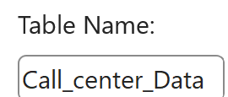

Task 1
Pivot Table Preparation:
Ensure the dataset is:
Properly formatted
Free of blank headers
Converted into an Excel Table
Create a new worksheet named Pivot_Analysis

Slide 3
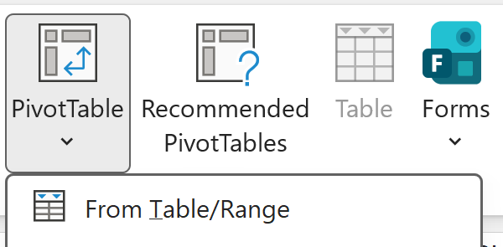
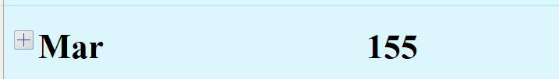


Task 2
Call Volume Analysis:
Create a Pivot Table that shows:
Which month has the highest number of calls?
Are there noticeable seasonal patterns?
Calls are highest in spring, lower in summer, and recover in October
Which representative handled the highest number of calls?
Is the workload evenly distributed?
Which representative has the highest average satisfaction?
Are high call volumes linked to lower satisfaction?
Yes. The workload is fairly evenly distributed among representatives
Higher call volumes are slightly linked to lower satisfaction.

Slide 4




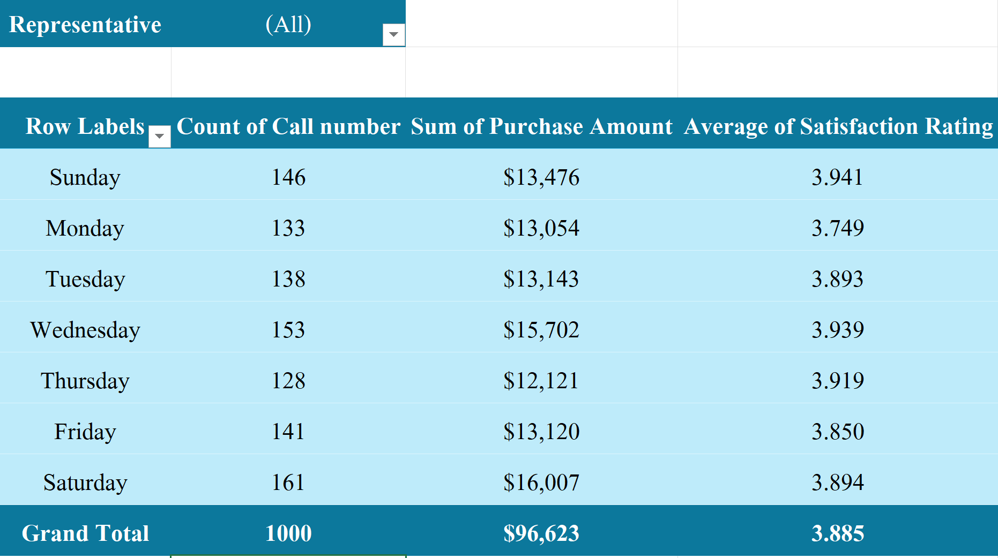
Task 2
Call Volume Analysis:
Create a Pivot Table that shows:
Which call duration range is most common?
Which representative generated the highest revenue?
Does higher revenue correlate with higher satisfaction?
Which day has the highest call volume?
Which day has the best customer satisfaction?
How does performance change when filtering by city or representative?
Performance varies by representative, with differences in call volume, revenue, and satisfaction levels
No, there is no clear correlation between revenue and satisfaction

Slide 5
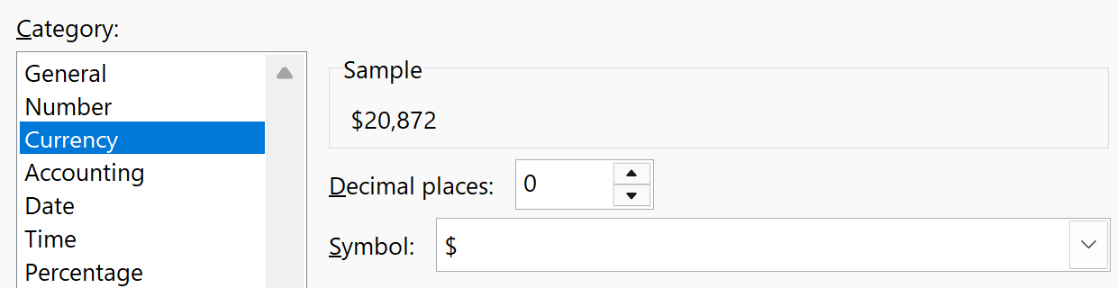
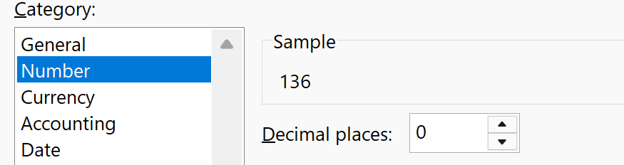
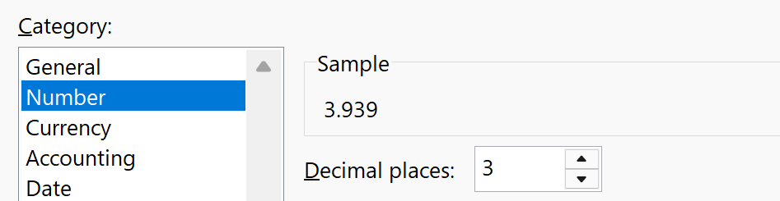
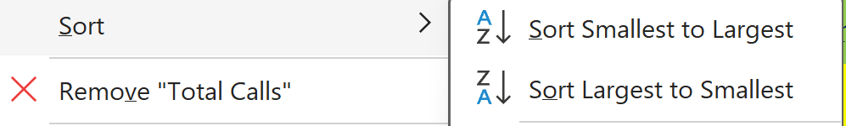
Task 3
Pivot Table Formatting & Sorting:
Apply professional formatting:
Clear headers
Number formatting
Sorted values (highest → lowest)

Slide 6
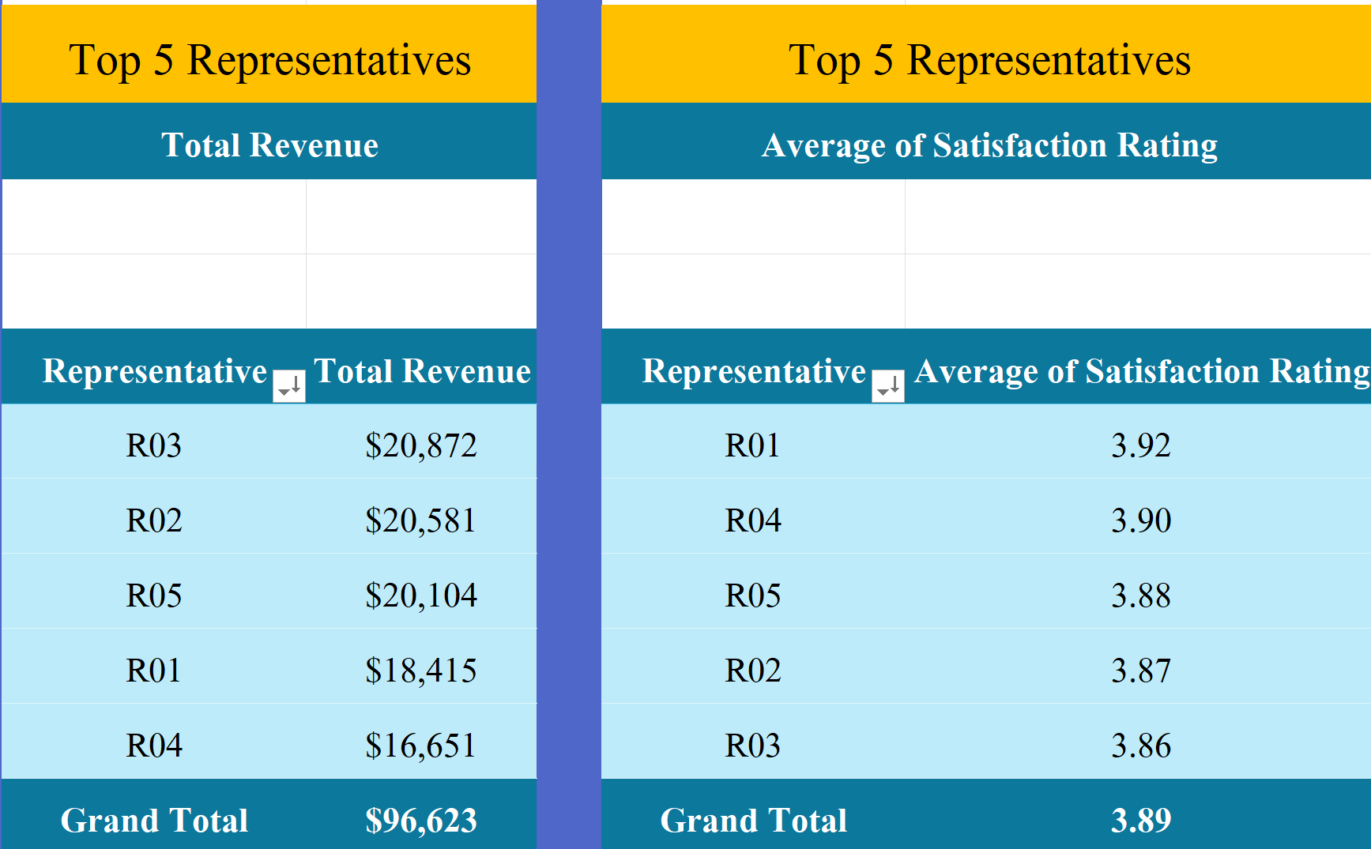
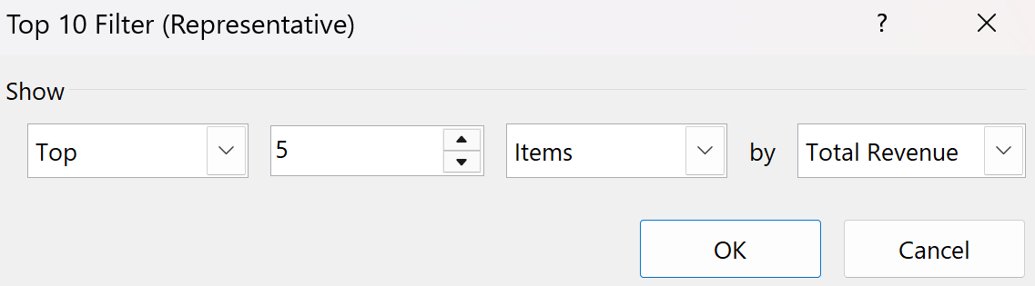
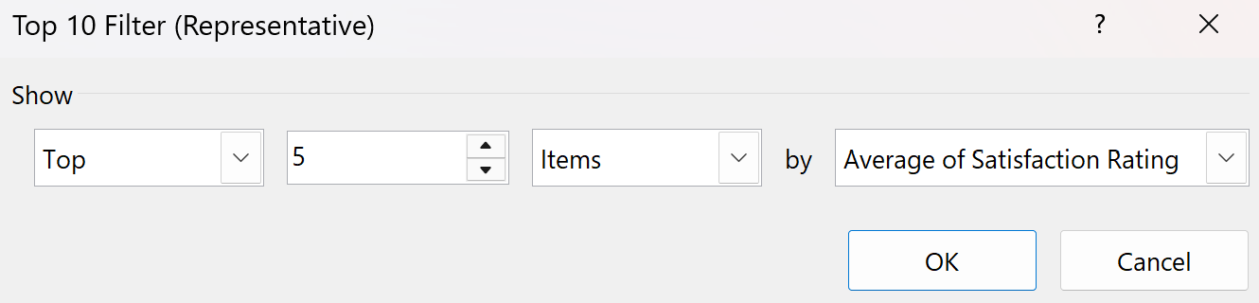
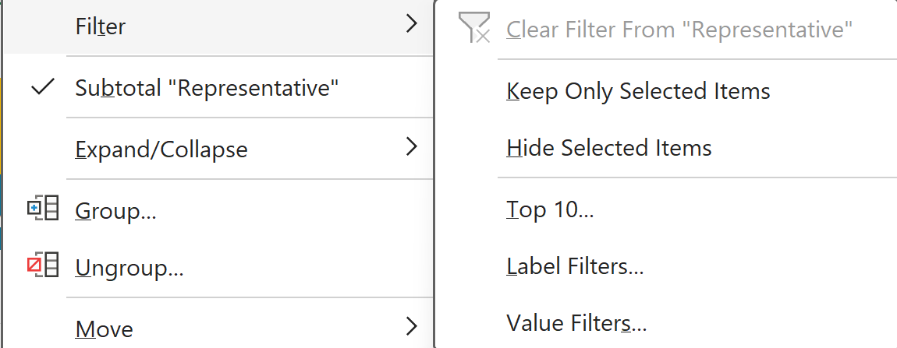
Task 3
Pivot Table Formatting & Sorting:
Rename Pivot fields to business-friendly names.
Create a Top 5 Representatives Pivot Table based on:
Revenue
Satisfaction

Slide 7

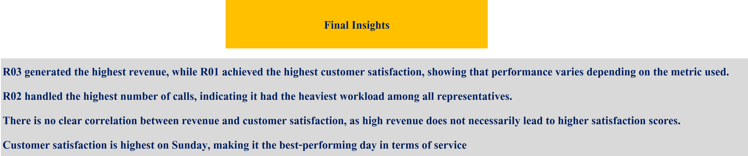
Task 3
Pivot Table Formatting & Sorting:
Add a new sheet named Call_Center_Insights
Write 3–4 clear business insights, such as:
Best-performing agents
Peak call times
Revenue vs satisfaction patterns

